Slide 1
A Fast Regular Expression Matching Engine for NIDS Applying Prediction Scheme
Author: Lei Jiang, Qiong Dai, Qiu Tang, Jianlong Tan
and Binxing Fang
Publisher: Computers and Communication (ISCC), 2014 IEEE
Symposium on
Presenter: Ching-Hsuan Shih
Date: 2014/12/23
Department of Computer Science and Information Engineering
National Cheng Kung University, Taiwan R.O.C.
Notes:
1

Slide 2
Outline
Introduction
Related Work
J-DFA Algorithm
State Prediction Technique
Hardware Implementation
Notes:
2

Slide 3
Introduction (1/2)
Signature-based deep packet inspection has taken root as a dominant security mechanism in networking devices and computer systems.
Regular expressions are more expressive than simple patterns of strings and therefore able to describe a wider variety of payload signatures.
Notes:
是一種裝置或者是軟體，用處是偵測網路中是否存在惡意的入侵式的動作。
大部分的IDS會解讀網路封包，系統日誌或者是網路流量來觀察是否有惡意的攻擊。
Pattern Matching是IDS中很重要部分，他用來找出packet中payload是否用包含惡意的動作，而這些惡意的動作我們會事先定義為pattern set

Slide 4
Introduction (2/2)
We develop a new DFA compression algorithm called J-DFA by clustering algorithm and encoding scheme.
The compression ratio reaches about 99%.
We develop a state prediction method for J-DFA.
The prediction success rate of J-DFA reaches more than 99.5%.
Based on J-DFA, we design a regular expression matching engine with state prediction unit on the newest Xilinx Virtex-7 chip.
The throughput reaches from 230 Gbps to 430 Gbps.
Notes:
是一種裝置或者是軟體，用處是偵測網路中是否存在惡意的入侵式的動作。
大部分的IDS會解讀網路封包，系統日誌或者是網路流量來觀察是否有惡意的攻擊。
Pattern Matching是IDS中很重要部分，他用來找出packet中payload是否用包含惡意的動作，而這些惡意的動作我們會事先定義為pattern set

Slide 5
Related Work
D2FA [7]: Kumar et al. observed that two states (S1, S2) have many same next states for the input characters. D2FA eliminates S1’s transitions by introducing a default transition from S1 to S2.
δFA [8]: They record the transition set of current state into a local memory and only store the differences between current state and next hop state.
A-DFA [10]: By introducing the notion of “state depth”, A-DFA constructs nearly optimal default paths. Compared with D2FA, A-DFA results in at most 2N state traversals when processing an input string of length N.
Notes:
特色是它可以同時match pattern set中的所有pattern
它可以支援較大型的pattern set
需要對pattern set做一些前處理來建立資料結構

Slide 6
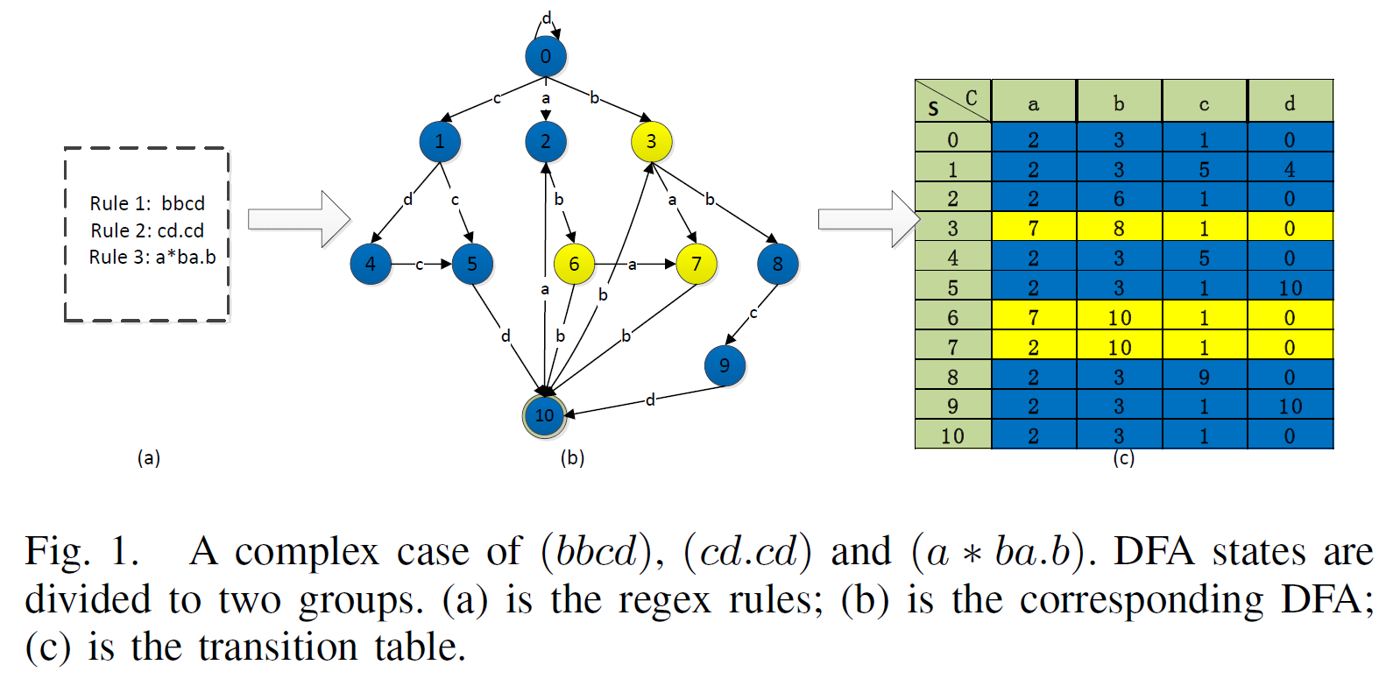
J-DFA Algorithm (1/2)
J-DFA algorithm is based on the observation below:
Almost every state has multiple similar states, with very little different transitions between them.
The transition table can be divided into one or more groups by putting similar states together.
Notes:
特色是它可以同時match pattern set中的所有pattern
它可以支援較大型的pattern set
需要對pattern set做一些前處理來建立資料結構

Slide 7
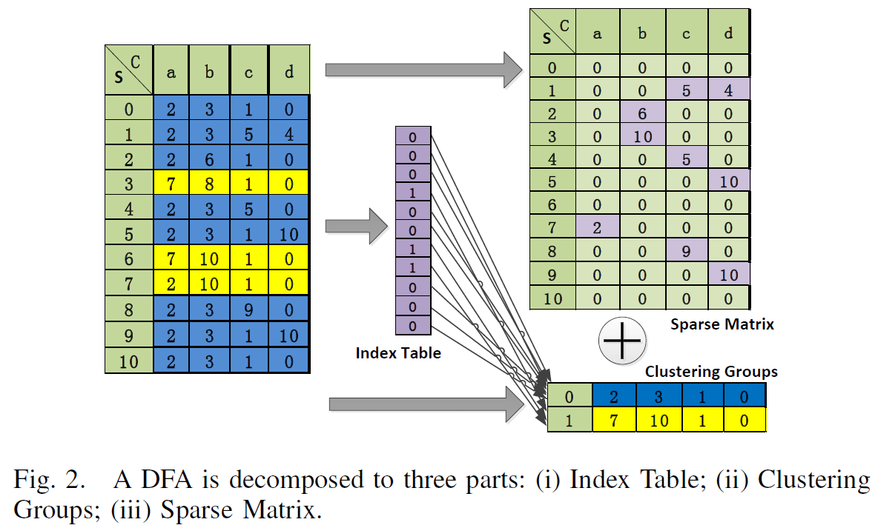
J-DFA Algorithm (2/2)
J-DFA algorithm has two steps:
First, decompose a DFA using clustering algorithm.
Second, further compress the storage space using runlength encoding scheme.
Notes:
特色是它可以同時match pattern set中的所有pattern
它可以支援較大型的pattern set
需要對pattern set做一些前處理來建立資料結構

Slide 8
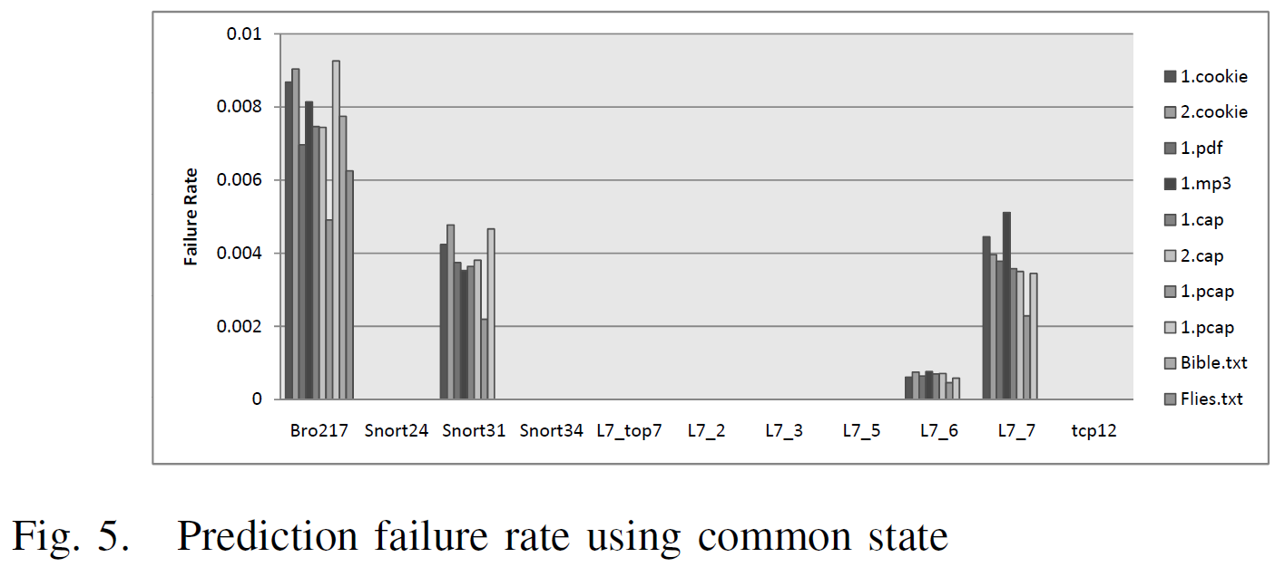
State Prediction Technique
When the input char c arrives, if the next state S_{common}(c) not equal to S_{current}(c), the prediction fails.
Expect Bro217, the failure rate of J-DFA is lower than 0.5%.
For sime cases, the failure rate is 0%.
Notes:
特色是它可以同時match pattern set中的所有pattern
它可以支援較大型的pattern set
需要對pattern set做一些前處理來建立資料結構

Slide 9
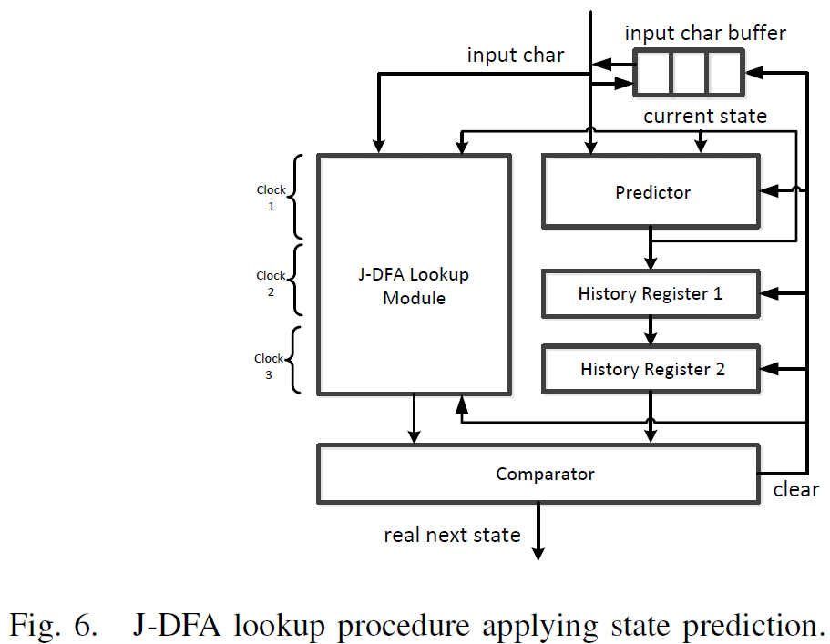
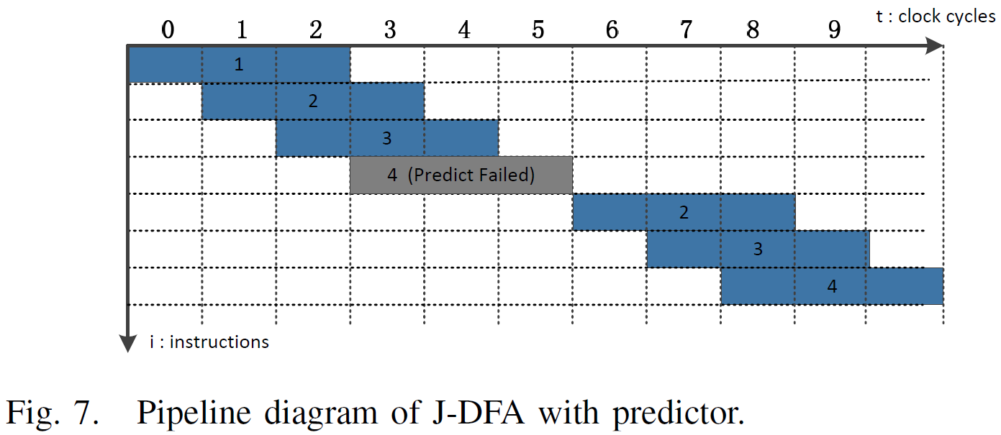
Hardware Implementation (1/2)
A. Mapping of State Prediction Scheme
Notes:
特色是它可以同時match pattern set中的所有pattern
它可以支援較大型的pattern set
需要對pattern set做一些前處理來建立資料結構

Slide 10
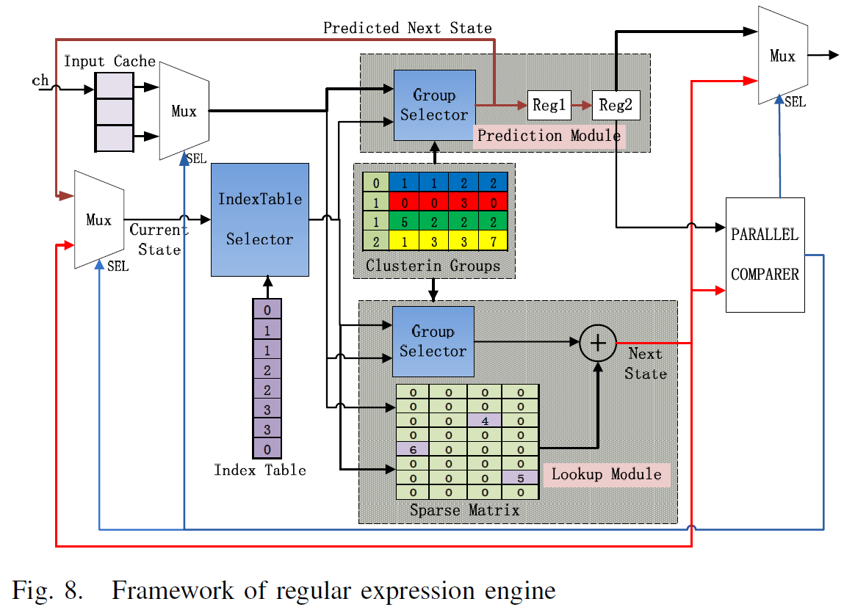
Hardware Implementation (2/2)
B. J-DFA Regex Matching Engine
Notes:
特色是它可以同時match pattern set中的所有pattern
它可以支援較大型的pattern set
需要對pattern set做一些前處理來建立資料結構

Slide 11
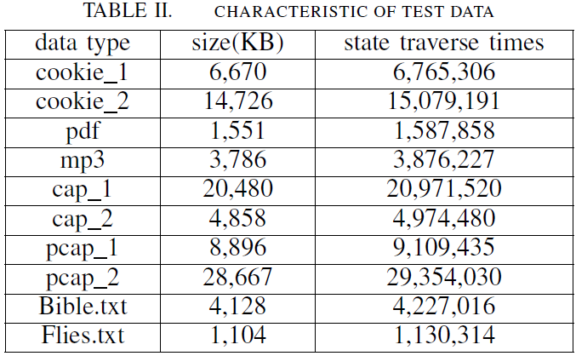
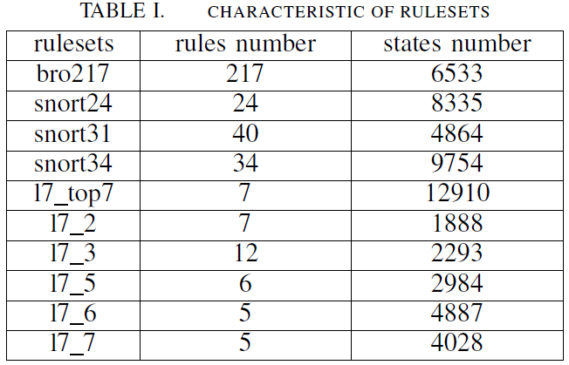
Hardware Implementation (2/2)
C. Performance Evaluation
Xilinx Virtex-7 FPGA chip
Notes:
特色是它可以同時match pattern set中的所有pattern
它可以支援較大型的pattern set
需要對pattern set做一些前處理來建立資料結構

Slide 12
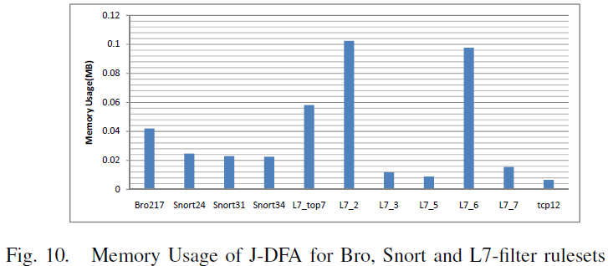
Hardware Implementation (2/2)
Notes:
特色是它可以同時match pattern set中的所有pattern
它可以支援較大型的pattern set
需要對pattern set做一些前處理來建立資料結構

Slide 13
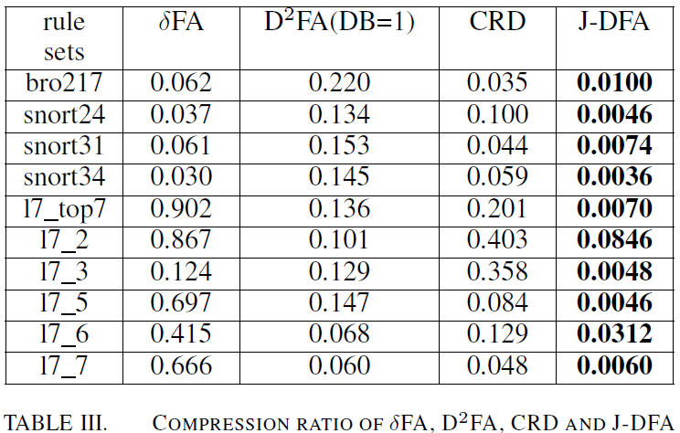
Hardware Implementation (2/2)
Notes:
特色是它可以同時match pattern set中的所有pattern
它可以支援較大型的pattern set
需要對pattern set做一些前處理來建立資料結構

Slide 14
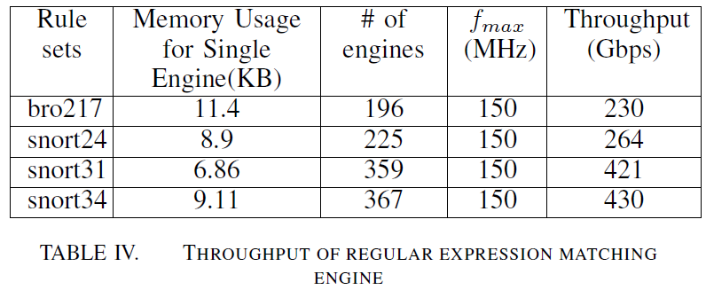
Hardware Implementation (2/2)
Notes:
特色是它可以同時match pattern set中的所有pattern
它可以支援較大型的pattern set
需要對pattern set做一些前處理來建立資料結構

